Slide 1
Analyzing student activity in the Computer Programming course
Tartu 2023

Slide 2
Team Introduction
Project Owner : Reimo Palm – course instructor
X
Classifying students, Intermediate Presentation
Xinyue Zhang
Yucui Wu
Lanxiang
Zhang
Jian Zhang
Y
Data Cleaning, Predicting final scores, Final Presentation
L
Result analysis, Webpage construction of dynamic effect display
J
Build a framework for Classifying students, Continuous optimization

Slide 3
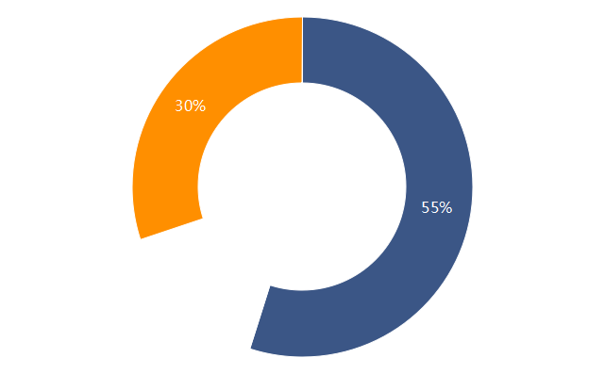
Project Motivation
Help students to modify their learning patterns to improve learning outcomes
Predict the final score based on
their early activity
Help teachers to change their teaching models to improve teaching effectiveness
Classify the students based on
their typical study patterns
Tap into more effective teaching models
and strategies

Slide 4
Methods - 1
Features
max score
max score + nr attempts
first score + last score + nr attempts
Models
Linear Regression
Decision Trees Random Forest
XGBoost
SVM
Evaluation
MSE
MAE
best
Experimenting with
different models
Feature Engineering
Data Preprocessing & Merging

Slide 5
Results - 1
MSE/MAE | max score | max score + nr attempts | first score + last score + nr attempts
Linear Regression | 252.1/11.8 | 250.7/11.6 | 258.5/11.9
Decision Trees | 333.7/12.6 | 423.3/14.2 | 395.0/14.3
Random Forest | 194.1/10.1 | 188.5/9.9 | 185.2/9.7
SVM | 571.0/16.4 | 368.2/16.4 | 568.8/16.3
XGBoost | 233.9/11.1 | 226.0/11.1 | 217.4/10.3
预测界面展示图
随机森林的效果提升折线图

Slide 6
Methods - 2
Genius type
They submit each assignment only 1 or very few times, but they get high grades and end up high final score.
聚类种类的效果对比
Effort type
They attempted a lot, their scores gradually improved each time, and their final scores were high.
Needs help type
They tried a lot, but their scores didn't go up significantly last week, and their final scores weren't very good.
sum of attempts + sum of max score + course score
cluster model:
Unmotivated learning type
They attempted very little, their scores were low, and their final scores were poor.

Slide 7
Results - 2
归类界面展示图
效果最好的模型提升折线图

Slide 8
Lessons
Data
Is there enough data?
Is the data balanced?
Is the data clean?
What kind of features should we choose?
quantity? quality?
Features
Models
How to choose a model?
How to tune a model to get
better results?

Slide 9
Thank you !

